Slide 1
Grokking and how to accelerate it
Exploring promising grokfast algorithm modifications

Slide 2
Contents
Introduction to Grokking phenomenon
Initial concept
Where we observe it
Previous works
Grokfast algorithm
Promising results
Potential modifications and future directions

Slide 3
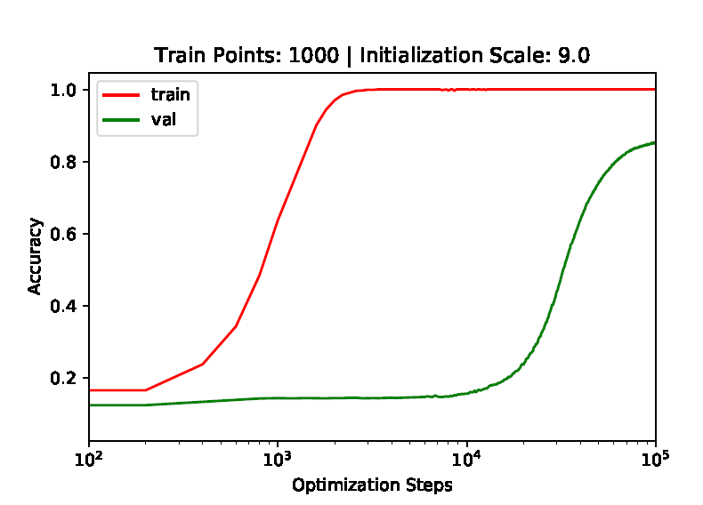
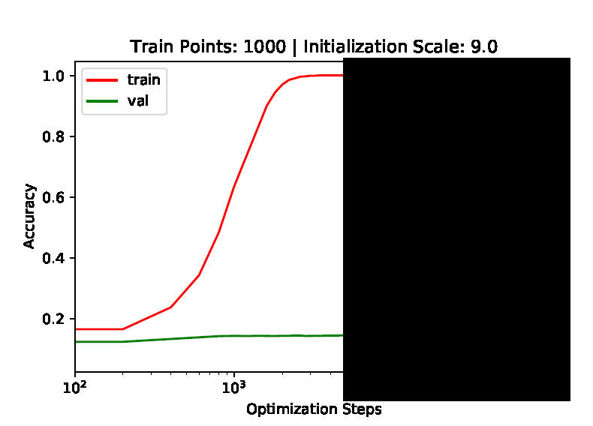
What is Grokking
Unexpected delayed generalization
Many iterations long after near perfect overfitting to the training data

Slide 4
What is Grokking
Unexpected delayed generalization
Many iterations long after near perfect overfitting to the training data
Firstly observed: “Grokking: Generalization Beyond Overfitting on Small Algorithmic Datasets” (Power et al.)(2022)
1000 times more optimization steps difference for validation loss to reach optimal value

Slide 5
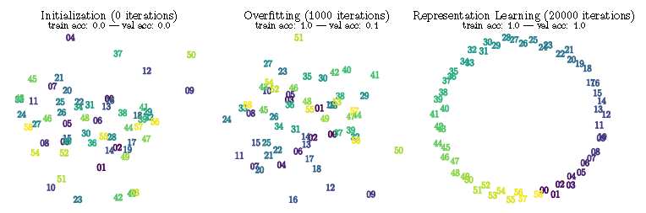
Connection with Representation Learning
“Towards Understanding Grokking: An Effective Theory of Representation Learning” (Liu et al.)(2022)
Relation with representation learning
Generalization occurs when the embedding space obtains “structure”
During the long overfitting phase it doesn’t have the “right structure”
Other tuning hyperparameters
decoder learning rate
weight decay
critical training size

Slide 6

What is Grokfast
“Grokfast: Accelerated Grokking by Amplifying Slow Gradients” (Lee et al.)(2024)
Goal:
Accelerate generalization phase of a model under grokking phenomenon
Method:
Treat the gradient of each parameter as a time signal g(t)
Parameter update rule:
Hypothesis:
Fast-varying components of update u → rapid overfitting
Slow-varying components of update u → slow generalization
g(t) is linearly correlated with u
Main idea: Amplify the low frequency component of g(t) since this is responsible for generalization

Slide 7
What is Grokfast
Implementation
Low pass filtering the g(t)
λ is filter gain (hyperparameter)
Two algorithms:
Moving average (MA)
Exponential moving average (EMA)
MA algorithm
Window of length w (hyperparameter)
Calculate moving average
Limitation
w times more memory to store all the previous gradients
EMA algorithm
Scalar momentum a (hyperparameter)
More efficient than MA (recursive - no need to store all the previous gradients)

Slide 8
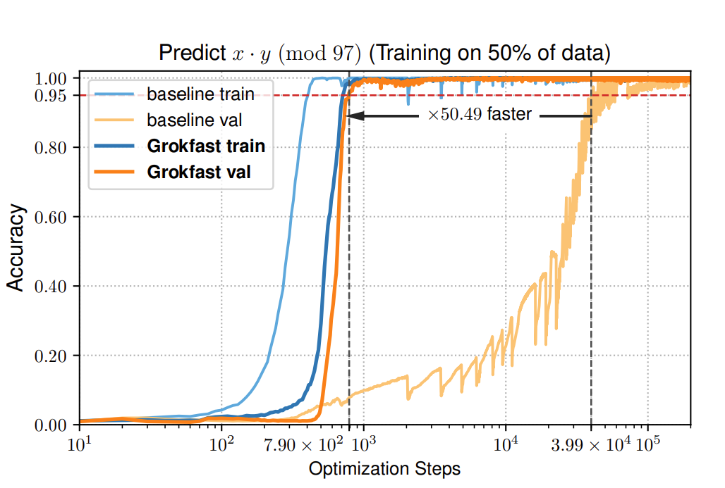
Results:
Accelerating the grokking phenomenon more than ×50

Slide 9
Experiments in diverse tasks
Also observed in a diverse set of tasks with larger and more complex datasets
Three-layer ReLU-MLP trained for MNIST classification task
Graph convolutional neural network (GCNN) trained for a molecule dataset QM9
2-layer LSTM network for sentiment analysis in the IMDb dataset
GROKFAST generally boosts performance and convergence speed in diverse tasks under the grokking phenomenon.

Slide 10
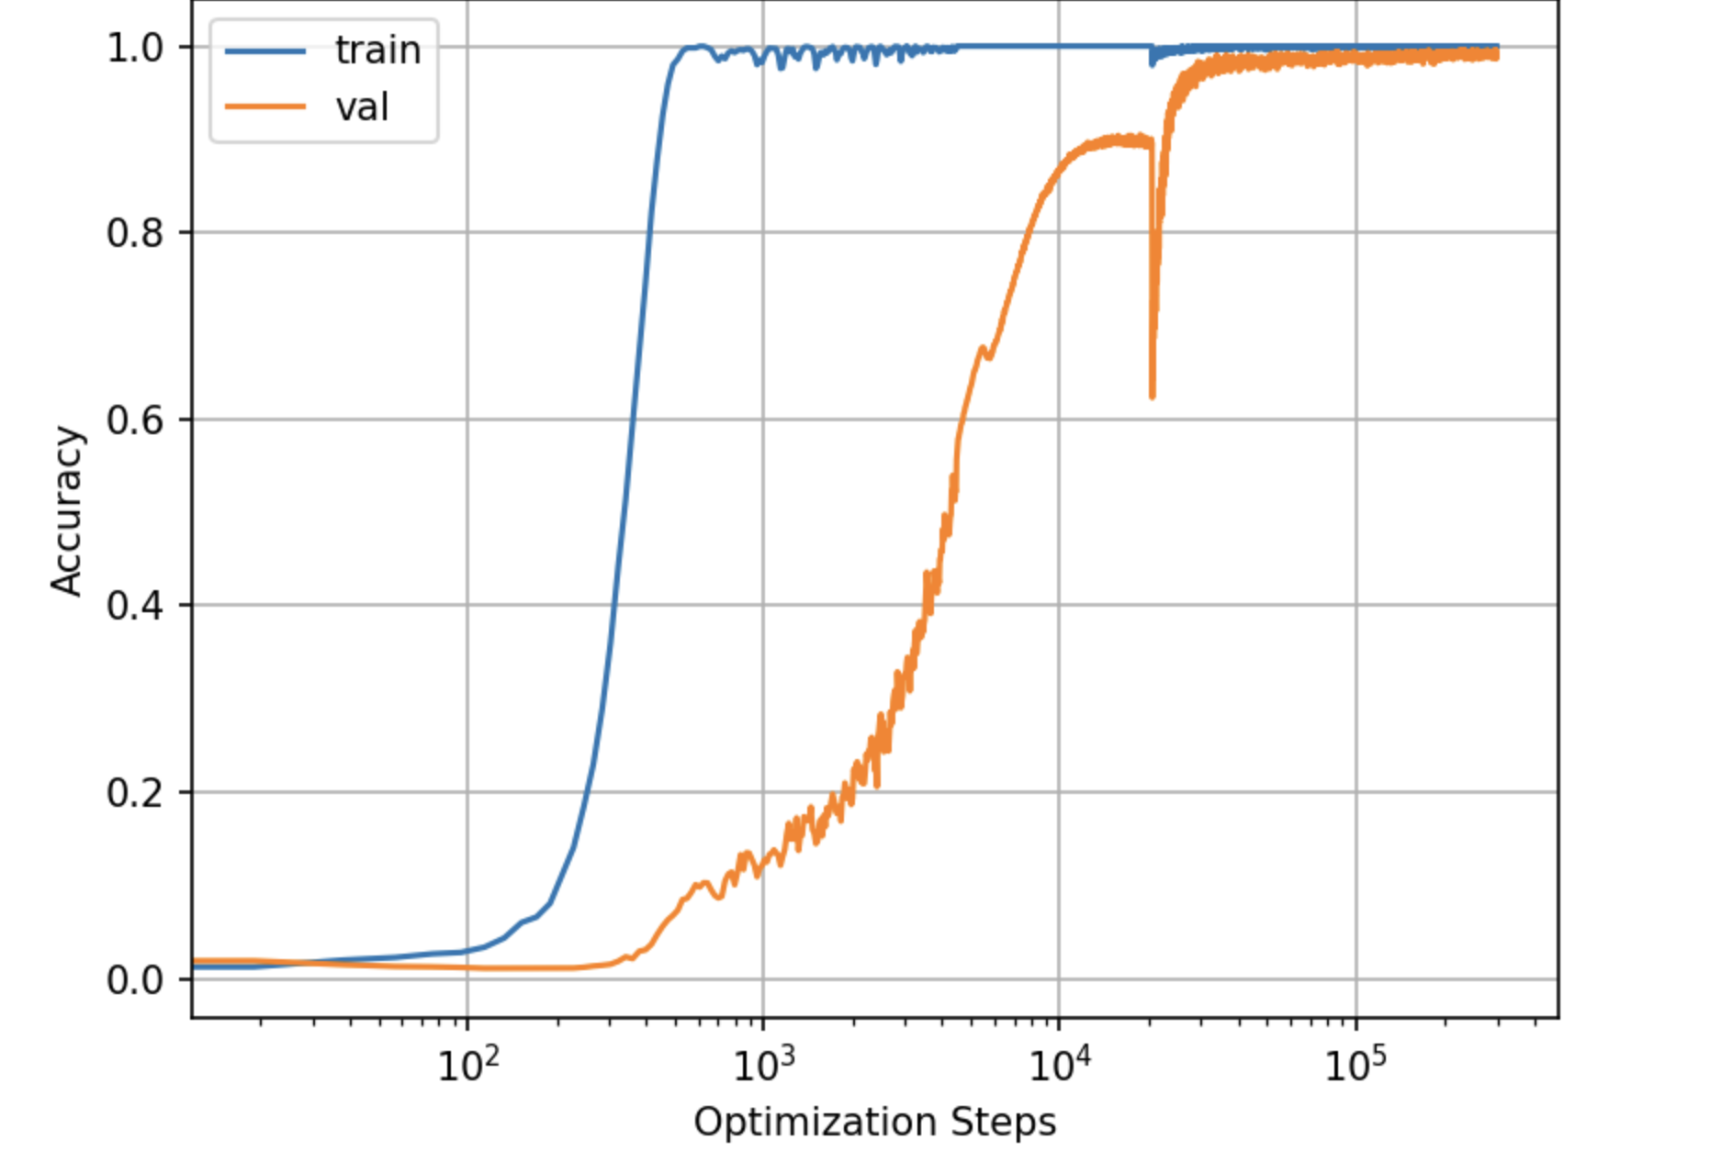
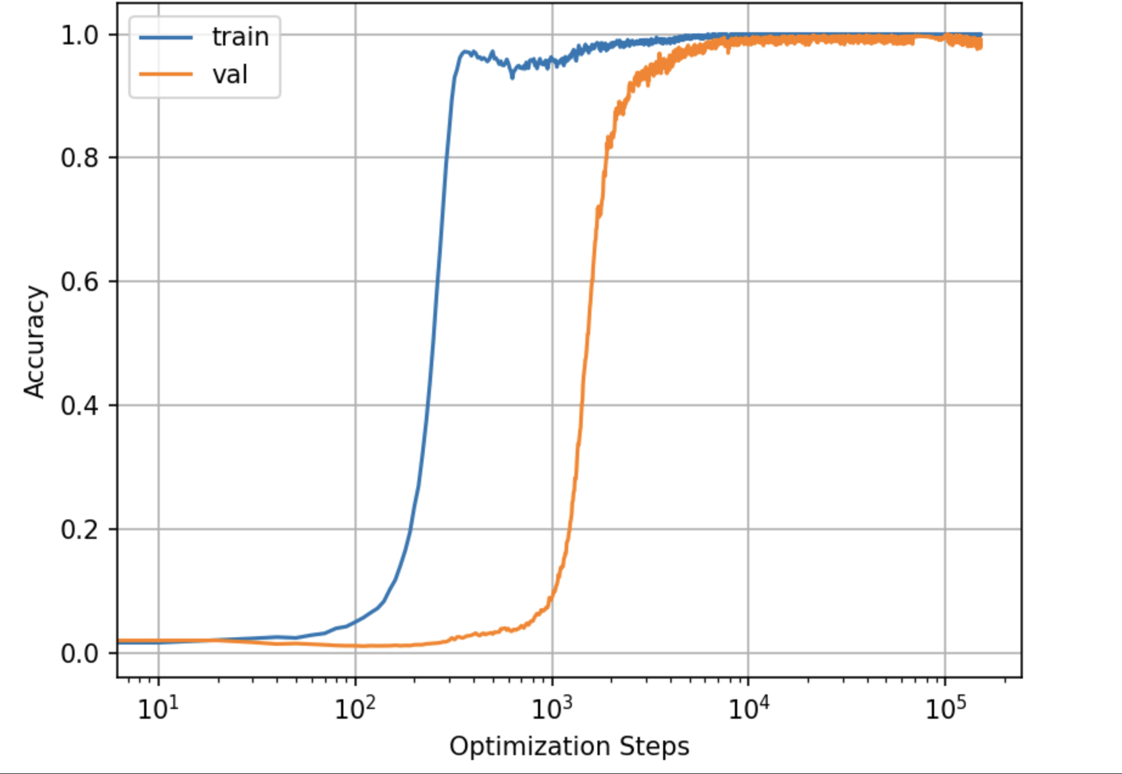
Our reproduction
Algorithmic Dataset (whole dataset)
Figure 1: Without amplification
Figure 2 : Using MA

Slide 11
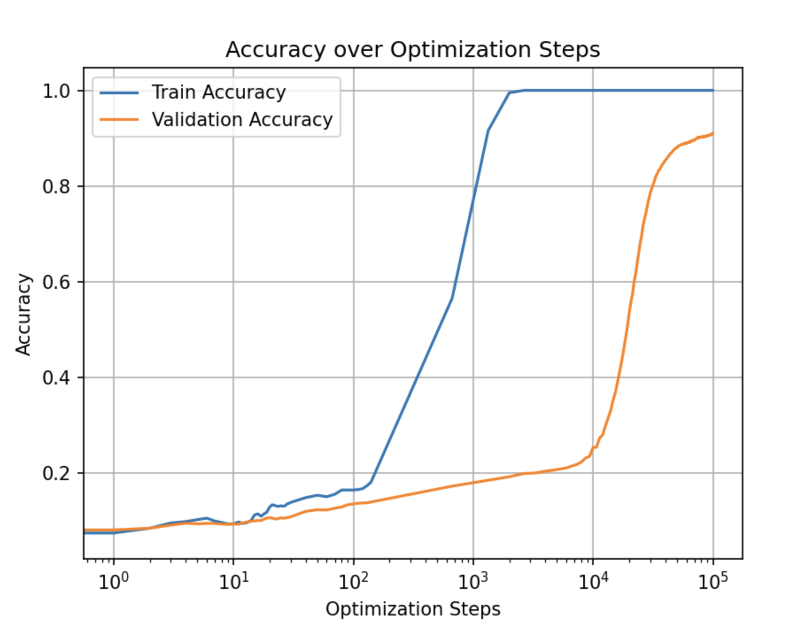
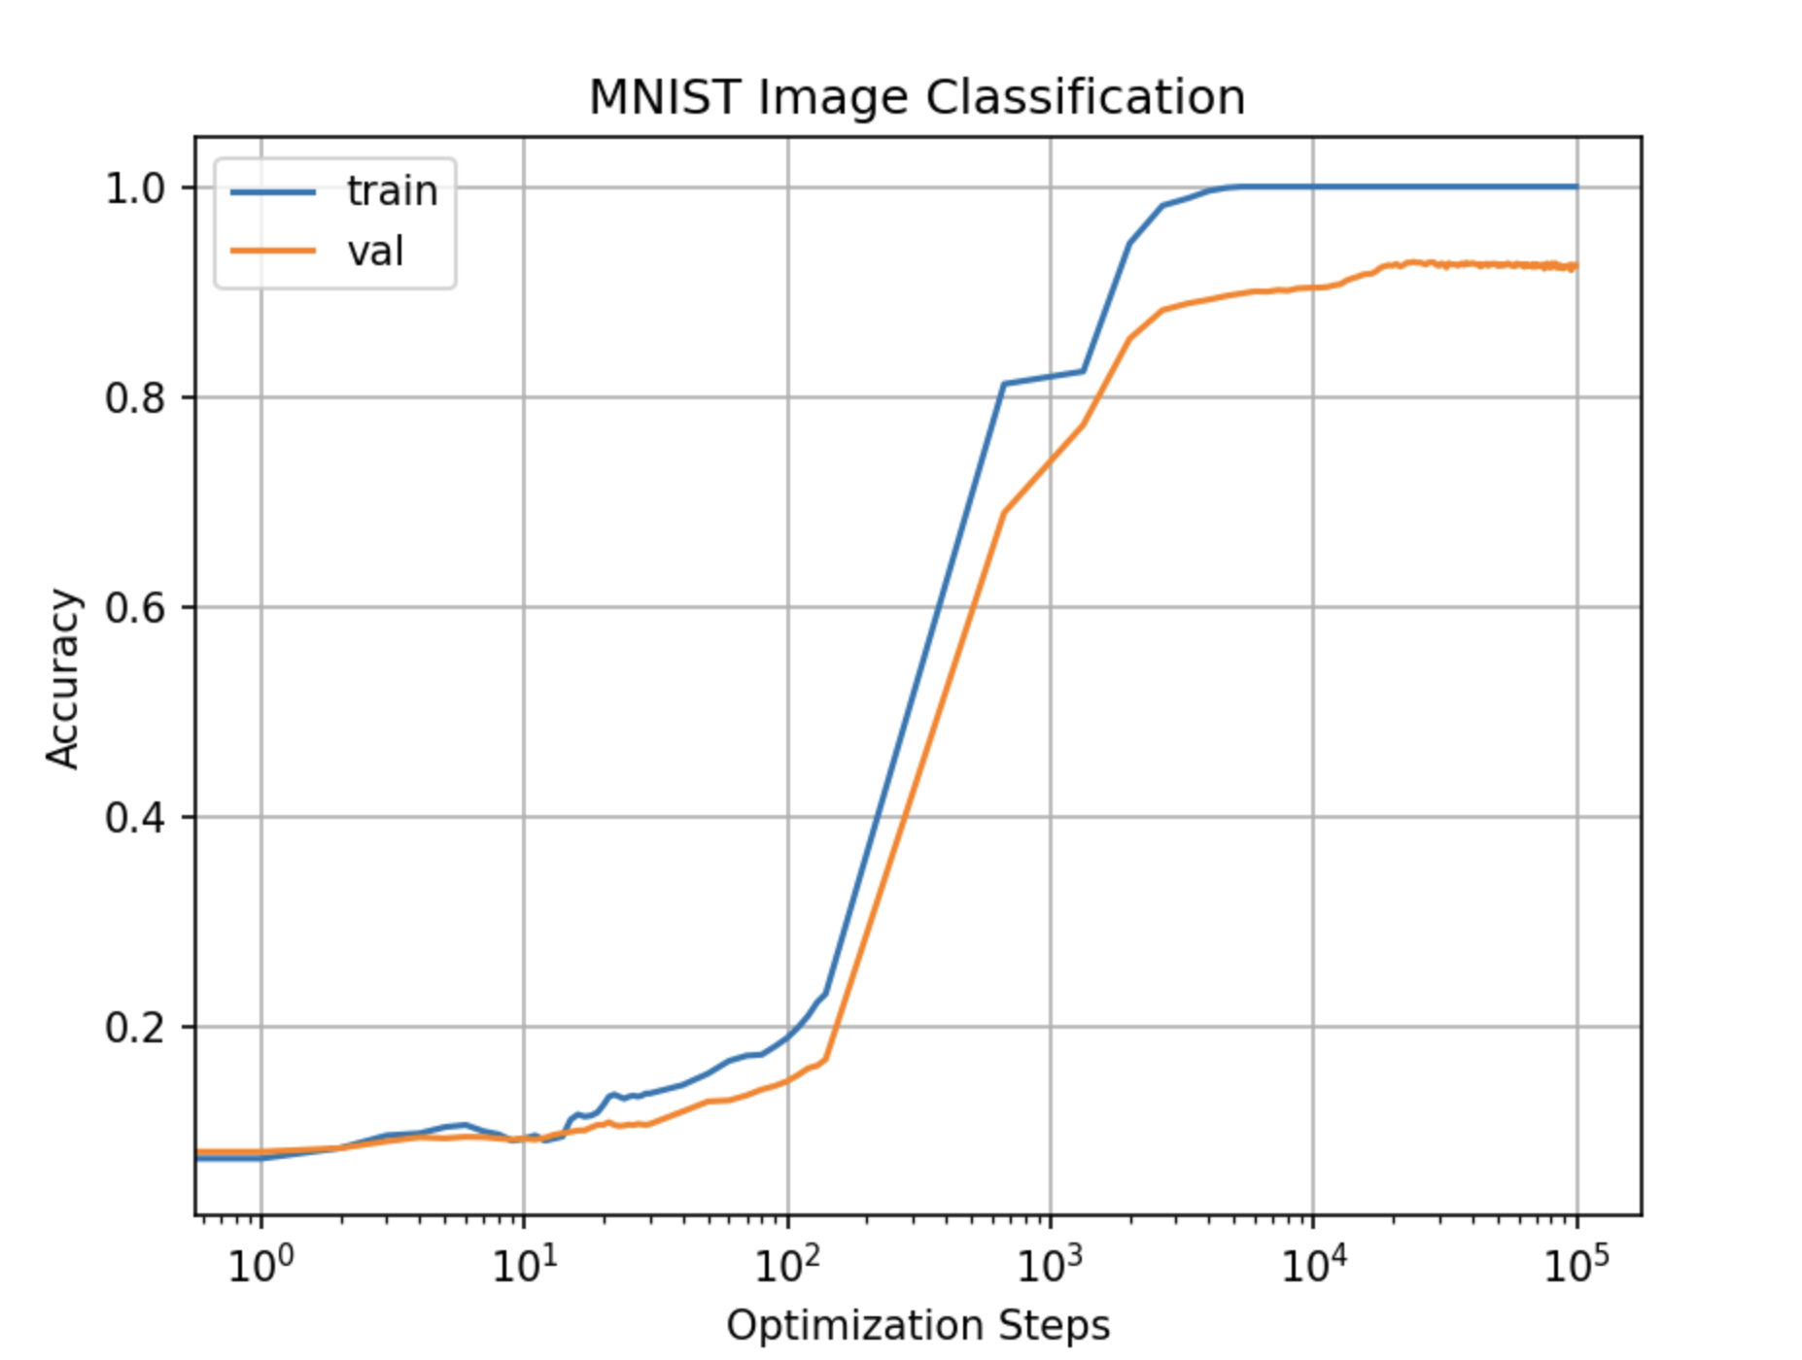
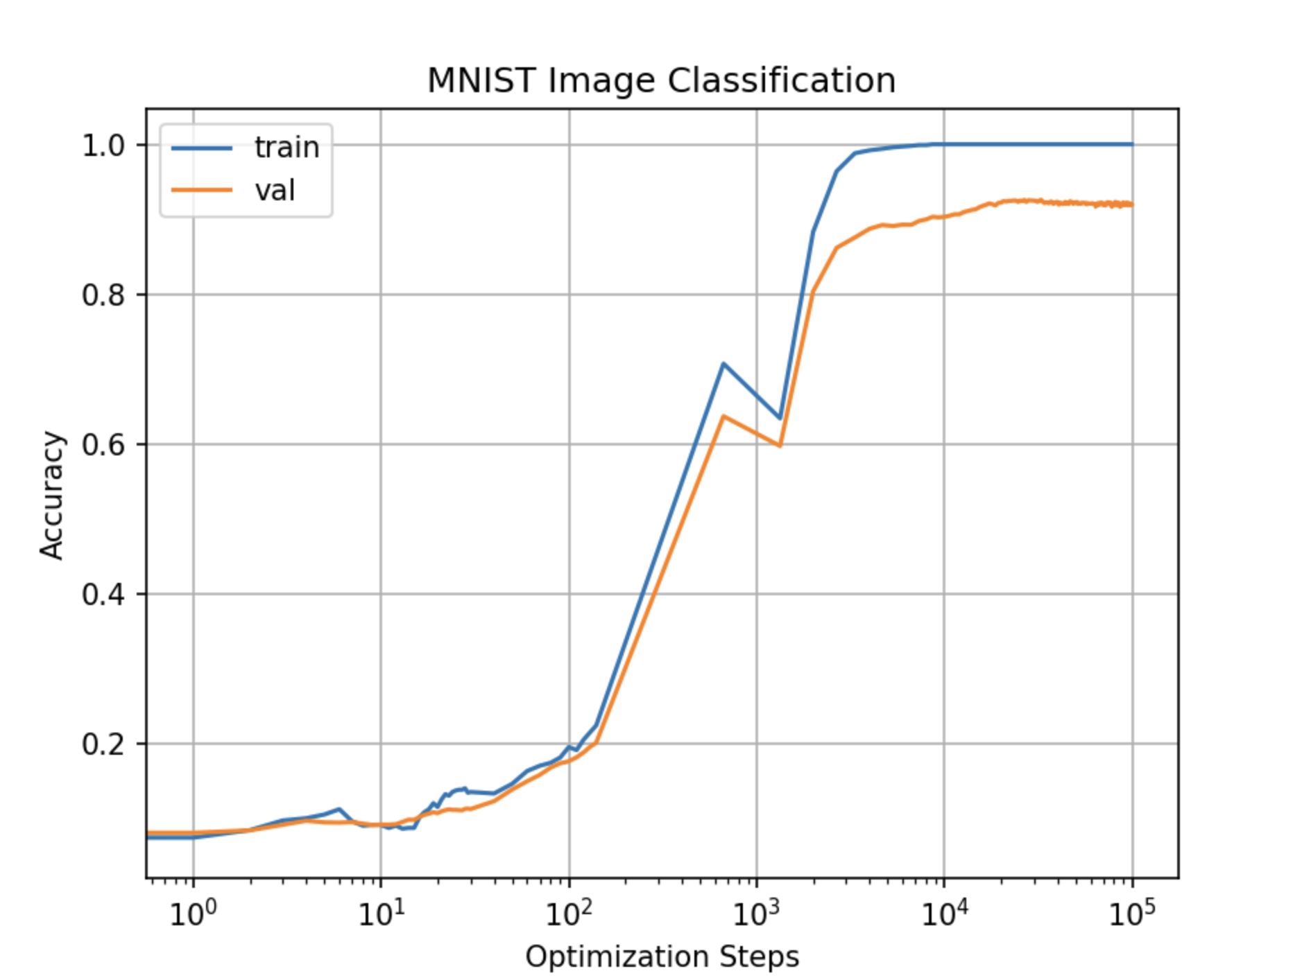
Our reproduction
MNIST (1 /6 of initial dataset)
Figure 1: Without amplification
Figure 2 : Using MA
Figure 3: Using EMA

Slide 12
Our ideas
Reduce high frequency component as well
Training Phase-Amplification dependence
Layer Depth-Amplification dependence
Study which samples induce low freq/high freq gradients

Slide 13
1. Reduce high frequency component as well
Grokfast’s approach
Amplify low frequency component
Completely removing the high frequency component → massive failure
Our modification
Don’t remove completely the high frequency component → instead reduce it by a factor (hyperparameter - grid search)

Slide 14
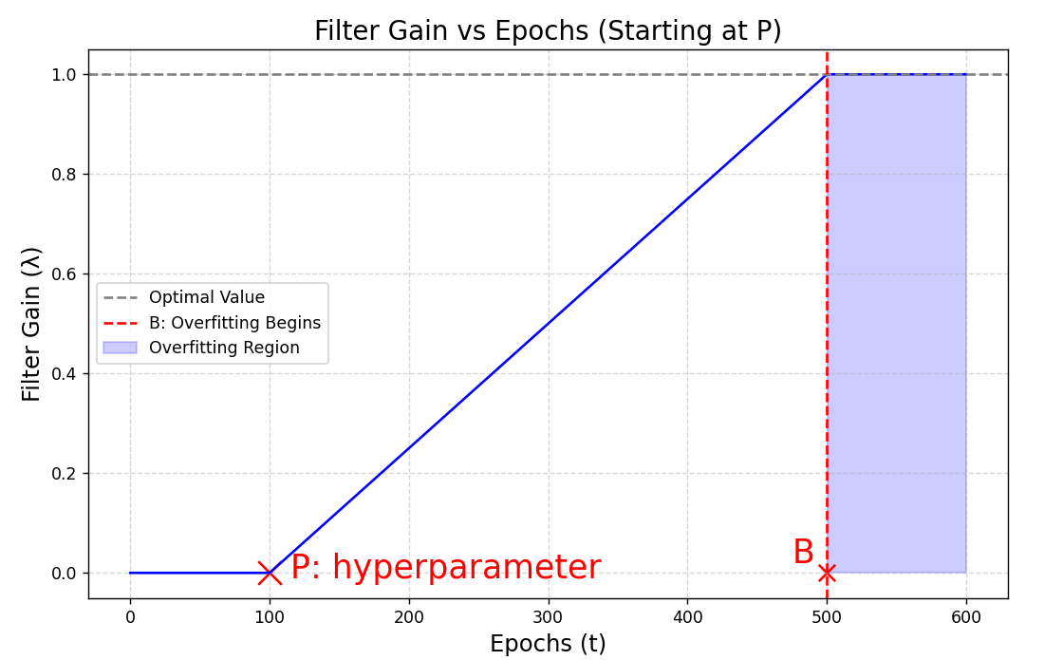
2. Training Phase-Amplification dependence
Grokfast’s approach
Start the filtering from the beginning (flatline gain)
Filtering only from overfitting phase and later → Faster grokking (step function gain)
Our modification
Follow Grokfast’s b. but gradually increasing the filter gain λ
Start increasing from P (hyperparameter - grid search)

Slide 15
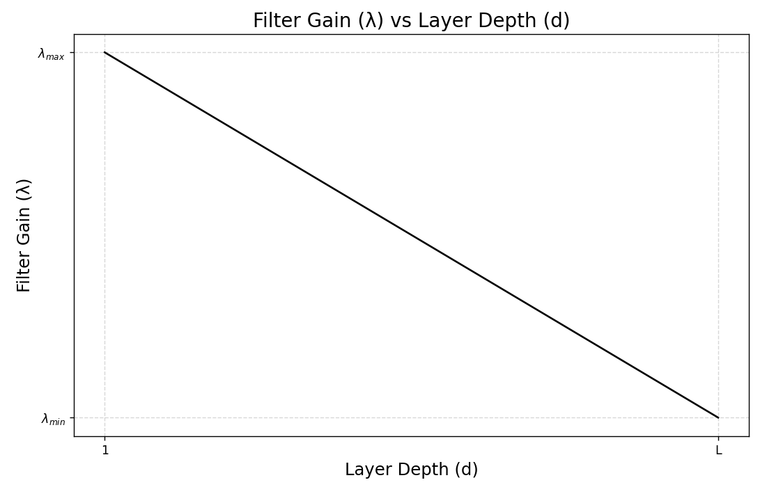
3. Layer Depth - Amplification dependence
Grokfast’s approach
Same filtering no matter what the depth of the parameter of this gradient
Our modification
The filtering will depend on the parameter’s depth
More amplification for the early layers - less for the later

Slide 16
4. Study which samples induce low freq/high freq gradients
Searching for a correlation between:
frequency that a sample induces ↔ importance of this sample to learning
See more in slide “Open questions”..

Slide 17
Open questions
Study which samples induce low freq/high freq gradients
Hypothesis: samples that induce high frequency gradients lie near the network’s decision boundary
Can we train the model more efficiently by mainly keeping these samples ?
Depth-Amplification dependence
Is depth correlated with grokking of network?
Our hypothesis: early layers need more low pass amplification than later layers
Early layers build embedding space → crucial for avoiding grokking
Not sure: maybe it’s the opposite

Slide 18
Μέλη της ομάδας
Νικόλας Ξηρός
Modifications 3,4
Μαρία Σαμπάνη
Modifications 1,4
Κωνσταντίνος Μπάρκας
Modifications 2,4
Πέτρος Πεσκελίδης
Modifications 3,4
Implement above modifications in
Algorithmic dataset
MNIST dataset

Slide 19
Resources
Google Colab free T4 GPUs for our reproduction
Maybe will need for extra paid version in the future
Models used are relatively small
Need for extensive experimentation
Grokking needs many iterations to occur

Slide 20
Thank you for your time
Questions ?

